Slide 1
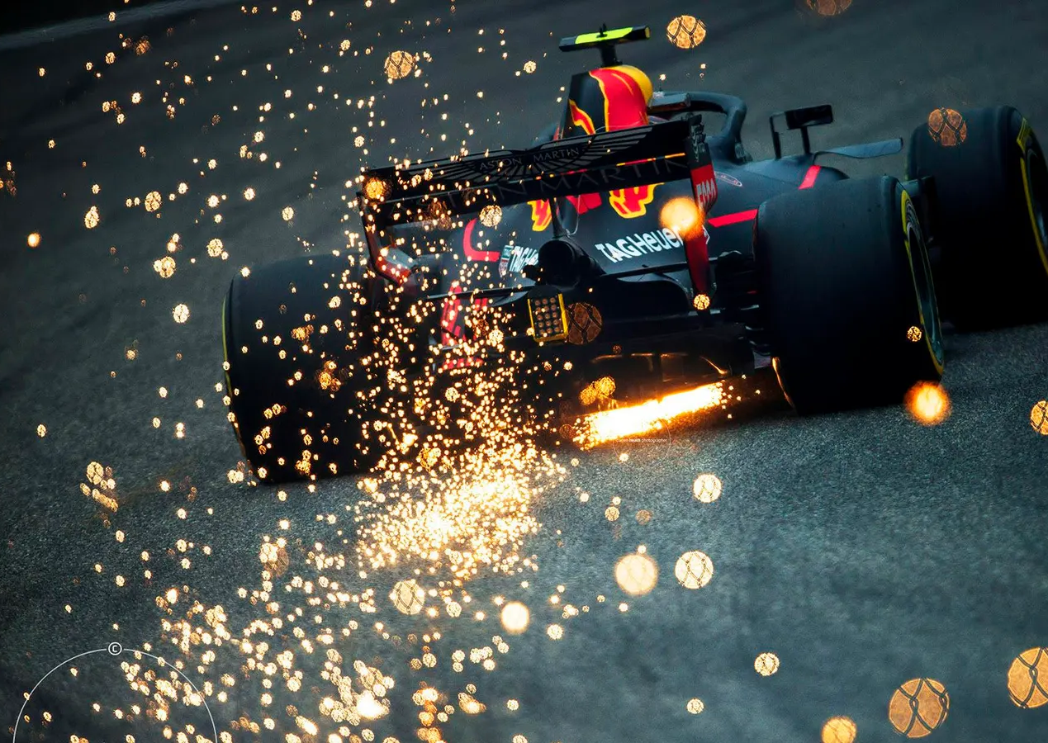
The Data Fueling Formula 1
Abby Brown

Slide 2
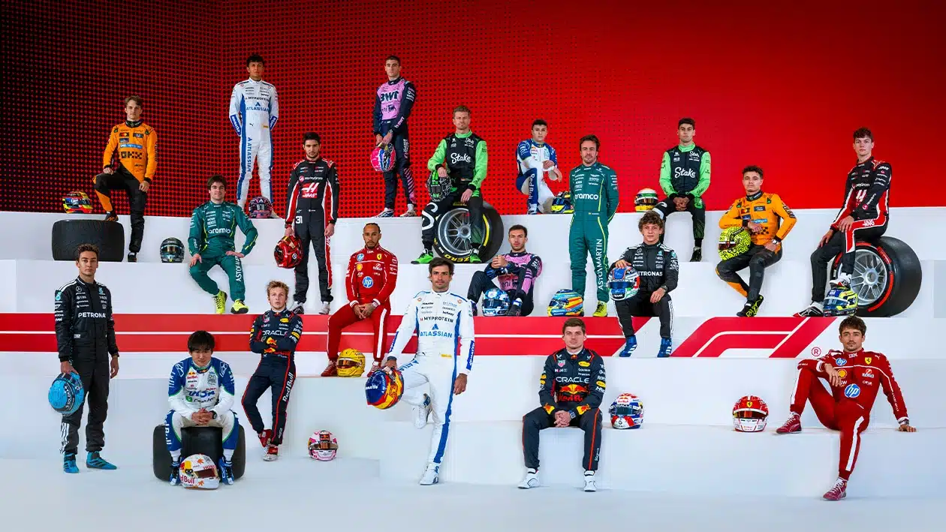
Overview
Pinnacle of Motorsport
Open wheel racing
10 teams, 20 drivers
Individual vs. Team Competition
Notes:
Formula 1 (F1) is the highest level of international motorsport. It features the fastest, most technologically advanced open-wheel race cars in the world. The name “Formula” refers to the set of rules that all teams and cars must follow and is derived from the formula of the gas that they use, or at least used to use.
There are 10 teams, each with two drivers, making 20 drivers total. The teams are some of the most well known car brands, and red bull for some reason, the most famous of which include Ferrari, McLaren and Mercedes
There is a team competition, called constructors where the two drivers must compete to get the most points in a season. There is also an individual competition, where the driver who gets the most points with will something called the World Drivers Champoinship, or WDC.

Slide 3
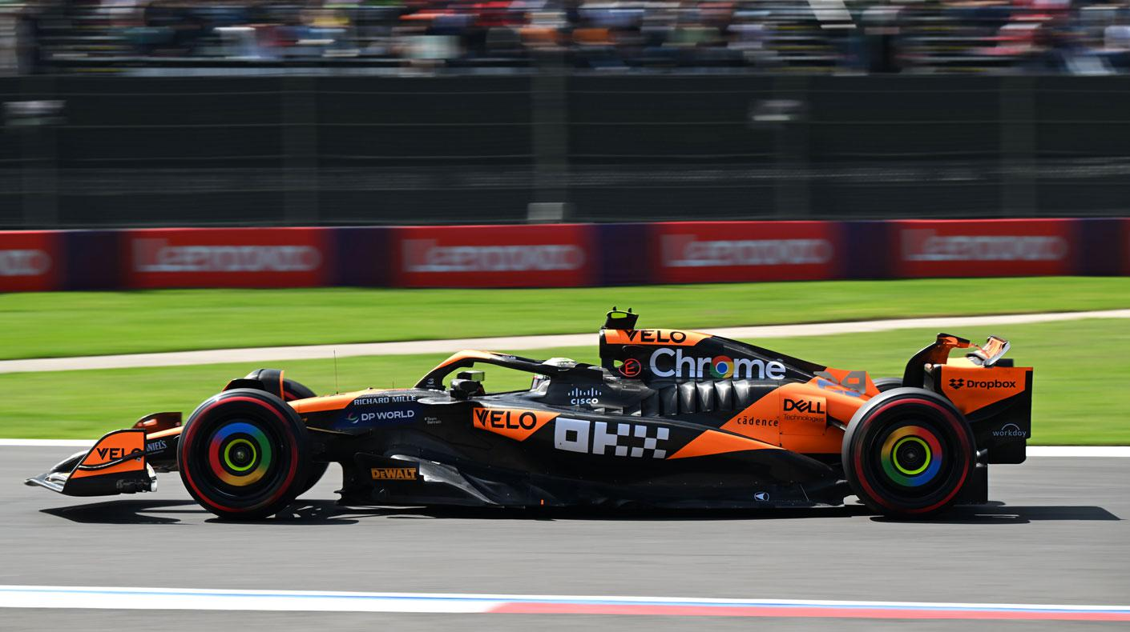
The Cars
Single seat
Open wheel
Hybrids
Speeds up to 220+ mph
Notes:
F1 cars are single-seat, open-wheel, hybrid machines.
They have a 1.6-liter, 90-degree turbocharged V6 internal combustion engine with a complex energy recovery system (ERS). (battery)
They can reach 220+ mph (350+ km/h) (though that is growing every year) and are designed using cutting-edge aerodynamics and engineering.
Teams spend hundreds of millions developing the cars each year.
To put it in perspective, F1 cars are valued at around 16 million per car, with estimates going as high a 20 million
Only some teams provide engines, and others have to use their engines to power their car. Those teams are Mercedes, Ferrari, Renault (Alpine), Honda, Audi, and Red Bull Ford Powertrains (coming next year)

Slide 4
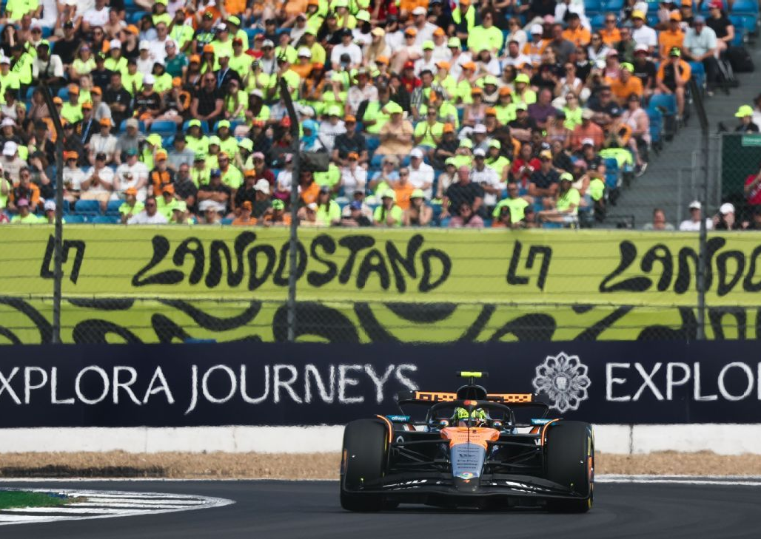
Race Weekend
24 races (this year)
Friday – Practice
Saturday – Qualifying
Sunday – Race
Points Breakdown
Notes:
Friday – Practice: Teams test setups
Saturday – Qualifying Drivers set the fastest lap time to determine the starting order
Sunday – Race: Usually 1.5–2 hours long, with pit stops, strategy, and tire management playing huge roles.
Typically, night races will race on Saturday night, like with Vegas this year, that started a 10 pm our time, 8 pm their time on Saturday night, as they want to test the drivers with different weather and temperatures
There are three different types of races, day, night, and street races. Street races are run on actual streets that normal people drive on, like Monaco or Vegas (the conditions are more unpredictable). Day races occur during the day, but they are typically run in the afternoon, while night races are only run after o'clock, typically because of temperature, to prevent overheating (Dubai)
Drivers and teams earn points based on finishing position.
1st place = 25 points
2nd = 18
3rd = 15 …down to 10th place = 1 point.
Drivers compete for the Drivers’ Championship; teams compete for the Constructors’ Championship (which also determines millions in prize money).

Slide 5

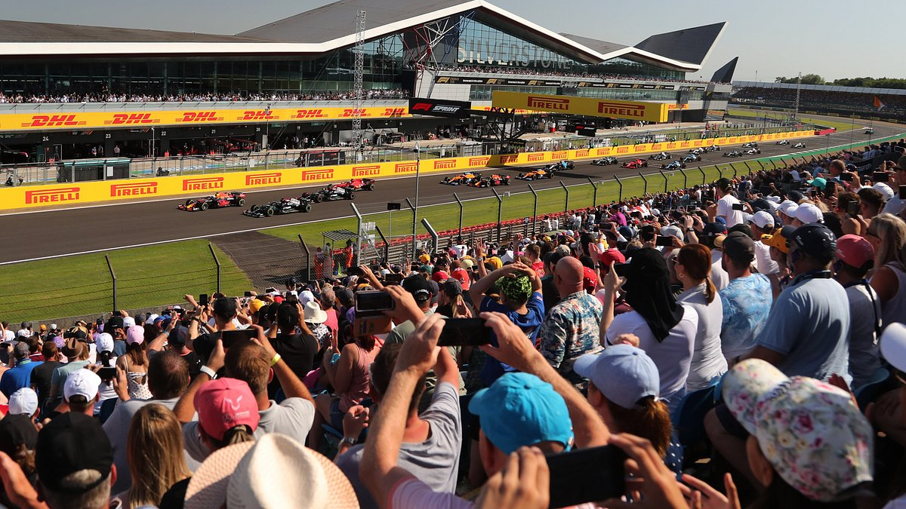
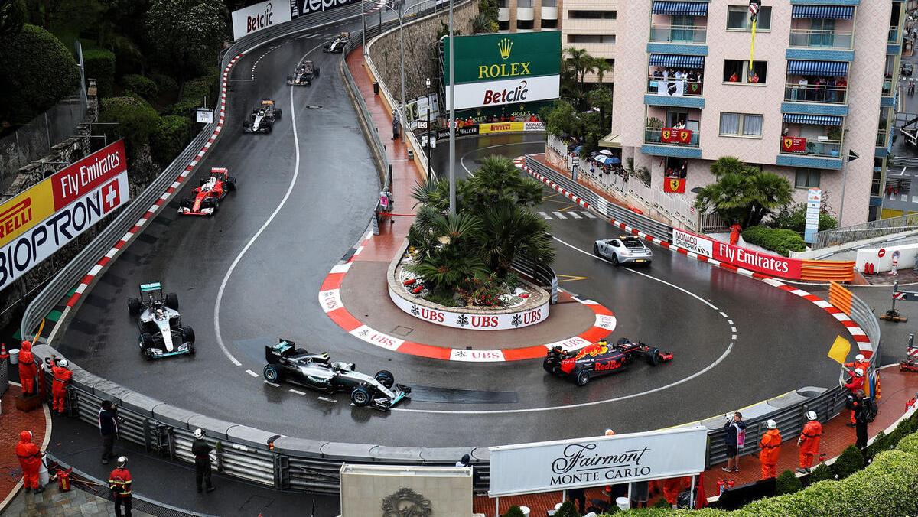
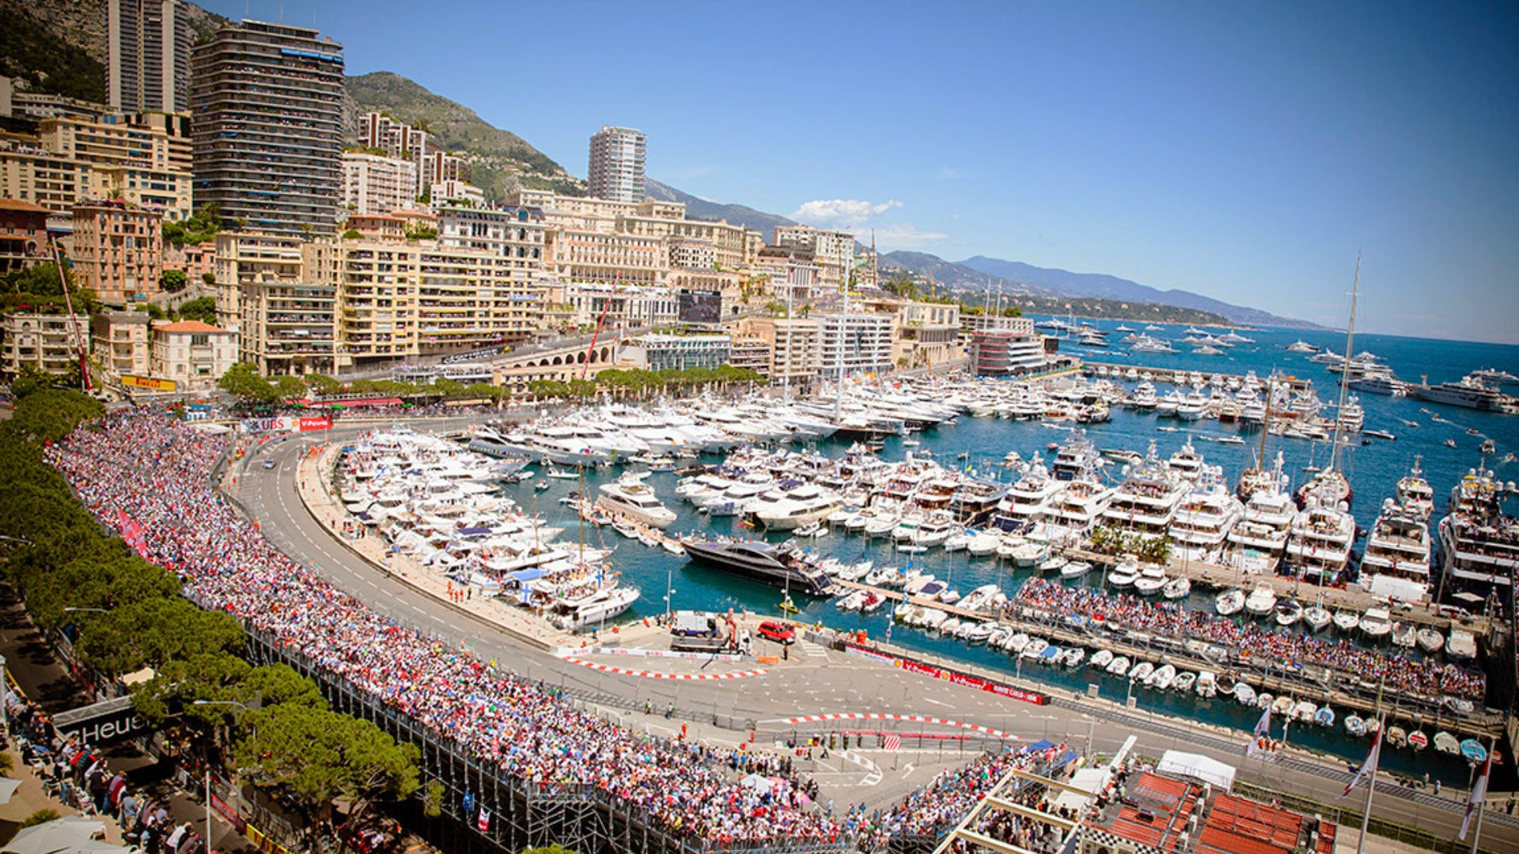
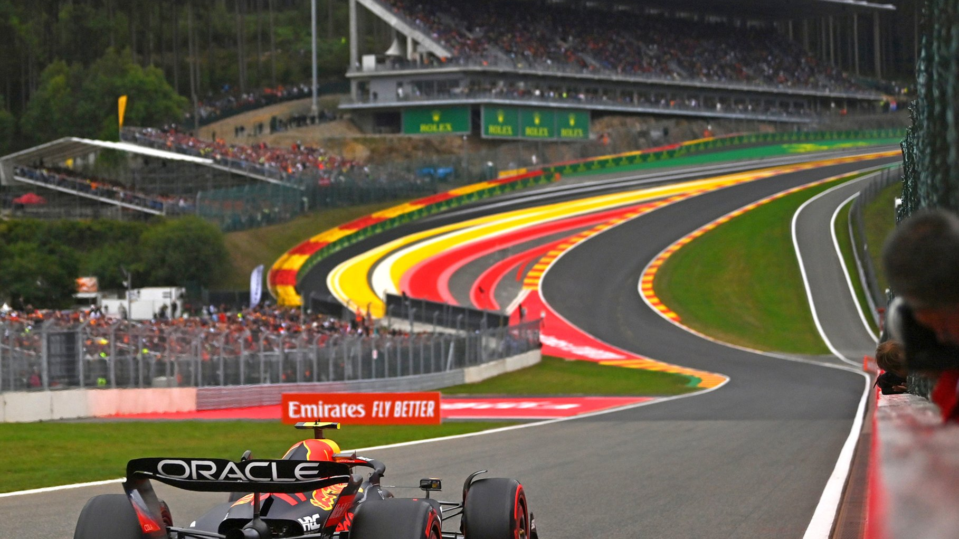
Tracks
Monaco
Silverstone
Spa
Notes:
Monaco – Prestige and Pure Driver Skill
Known as the jewel of F1, the Monaco Grand Prix is all about glamour, history, and perfection.
The track winds through the actual narrow city streets of Monte Carlo, leaving zero room for error, leading to many crashes and little over takes.
It’s the ultimate test of precision and bravery, and winning Monaco is considered one of the sport’s greatest achievements.
Monaco is a track that puts a lot of emphasis on qualifying, due to little overtaking in the race, so the strategy is frequently more centered on winning the qualifying and not DNFing in the race.
You may have also seen the iconic yachts picture, Monaco is one of the richest countries in the world, so it attracts a lot of celebrities and wildly rich people. Fun fact, the only way to access the circuit is by boat or bike, you cannot drive as the circuit covers the roads, only furthering the exclusivity of the race.
Silverstone – The Birthplace of Formula 1
Silverstone hosted the very first Formula 1 World Championship race in 1950, making it foundational to the sport’s history.
It’s known for fast, flowing corners like Maggotts–Becketts, which push cars and drivers to the limit.
British motorsport culture is deeply tied to Silverstone—many teams are based nearby, so it’s essentially F1’s “home race.”
It is also where all of the British drivers wish to win, most recently Lando Norris said that he would “give up the rest of his wins if he could win Silverstone”
Spa-Francorchamps – Pure Speed and Legendary Corners
Spa is famous for its dramatic elevation changes, long straights, and iconic corners like Eau Rouge/Raidillon.
It’s one of the longest and fastest circuits on the calendar, offering real racing challenges instead of just technical driving.
Drivers consistently name Spa as one of their favorite tracks because it combines speed, skill, and unpredictability—especially with its constantly changing weather.
Fun Fact: way back when, sometime in the 80’s, there were two drivers who dared each other to take Eau Rouge at full speed and see who could survive it, and they did it, because Formula 1 drivers are crazy like that. I believe both survived so not sure who won that one

Slide 6
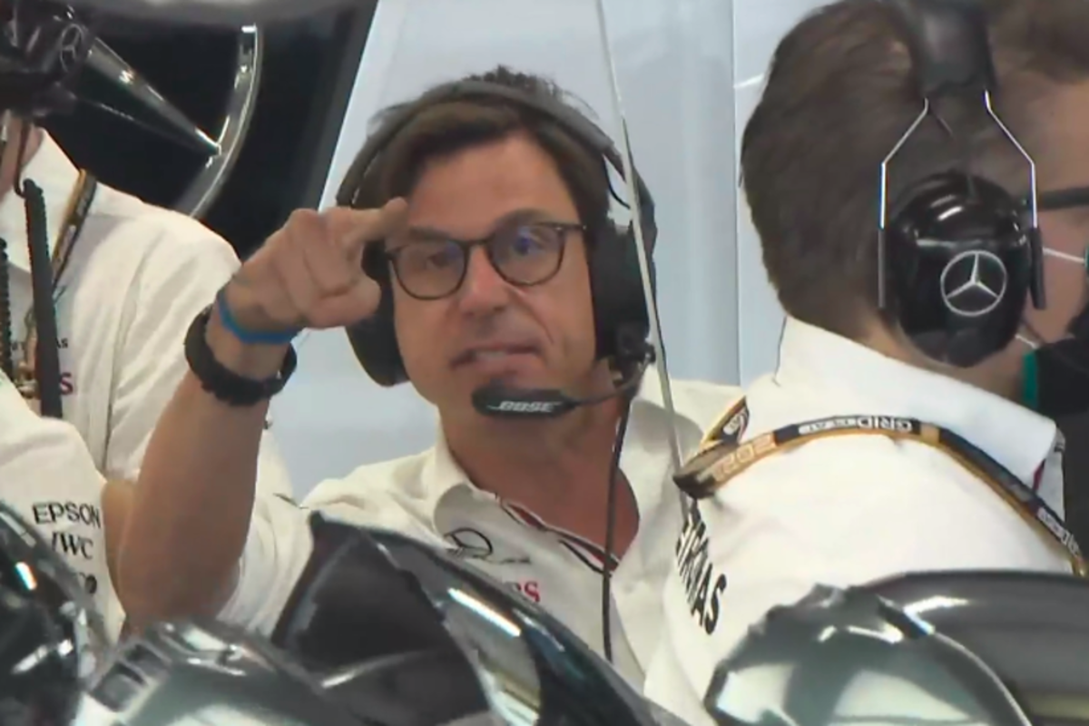
Initial Questions
No
Well, not for me
Is it possible to predict F1 race results using practice and qualifying data?
Is it possible to predict F1 race results based on sprint results?
Is it possible to predict the fastest lap times of a driver based on qualifying data?
Is it possible to predict one driver's qualifying time based on their teammate?
Is it possible to predict the qualifying position based on data from practices?

Slide 7

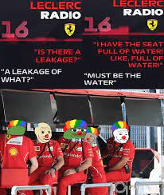
Struggles with Initial Questions
Performance prediction in Formula 1 is uniquely complex due to the interaction of car specifications, strategy, environmental variables, and dynamic, race-day uncertainties (van Kesteren & Bergkamp, 2023)
Advanced predictive modeling relies on deep telemetry, aerodynamic simulation, or proprietary team datasets

Slide 8
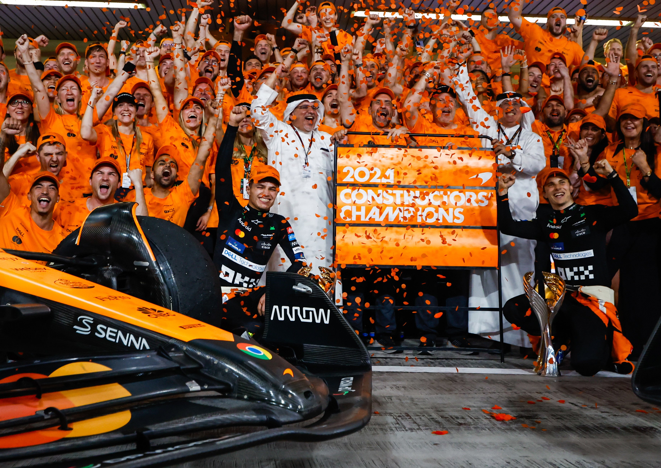
Updated Research Questions
Can grand prix circuits be classified by properties such as overtaking rate, pit stop duration, tire degradation, or layout complexity?
Which drivers consistently perform above expectation relative to circuit characteristics—i.e., which drivers demonstrate “anomalous,” exceptional performance?

Slide 9
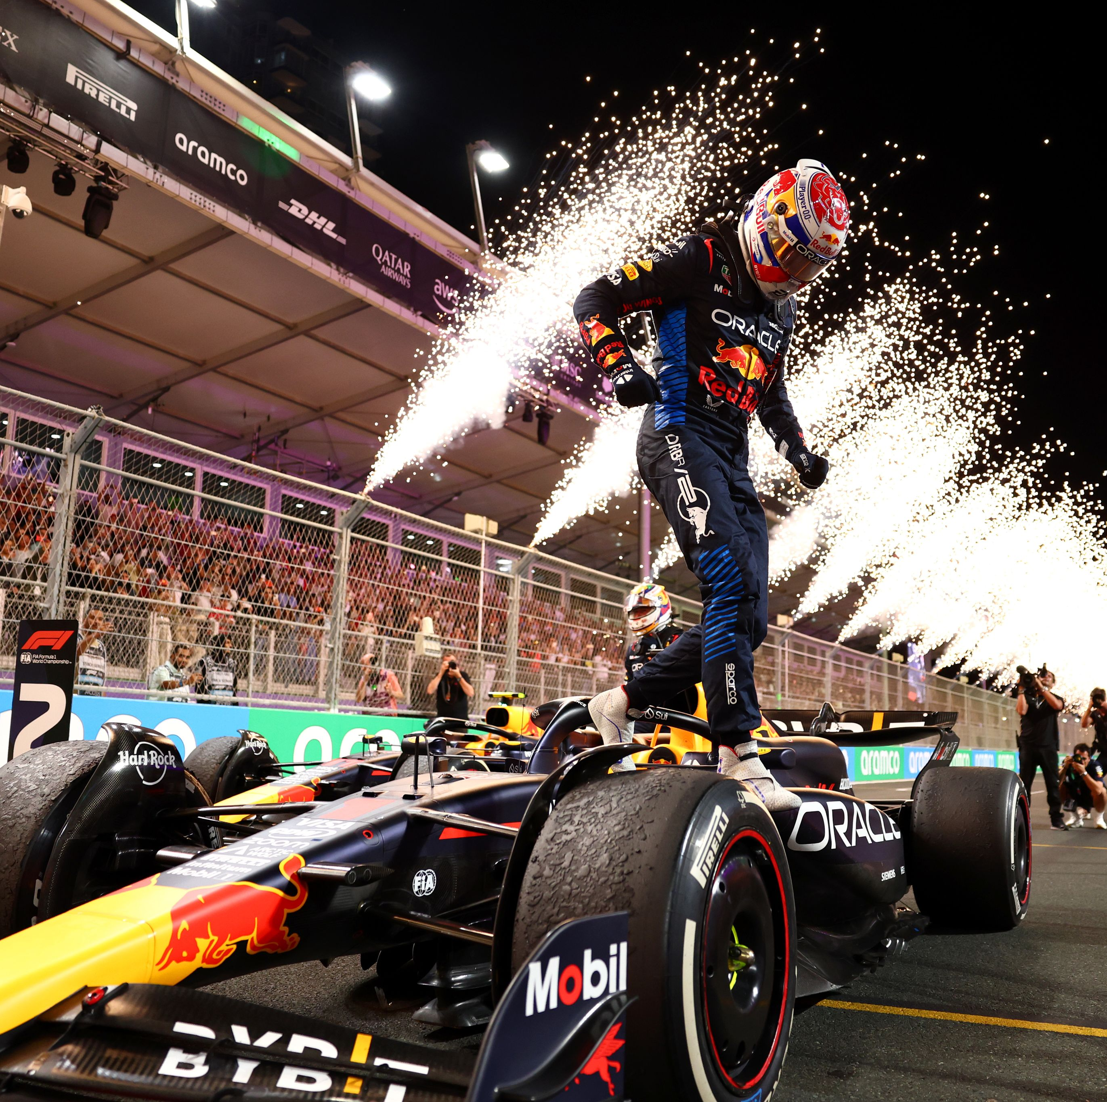
Models
Linear regression and least squares models
Interpretability and ability to quantify effect of individual features (Oliveira‑Silvino et al., 2024).
Limited when relationships are nonlinear
Notes:
Used for interpretability and ability to quantify the effect of individual features on outcomes (Oliveira‑Silvino et al., 2024).
Limited when relationships between features and performance are nonlinear or influenced by multiple interacting factors (typical with Formula 1 data)

Slide 10
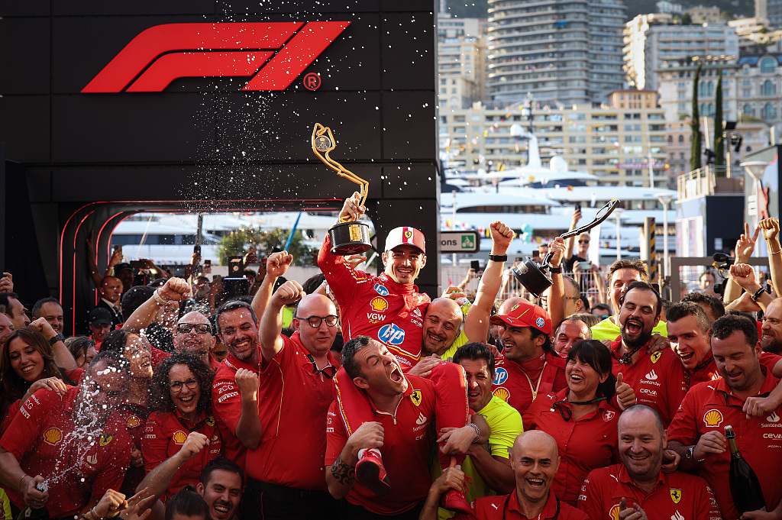
Models
Ensemble methods (random forest, gradient boosting)
Applied in diverse sports analytics to visualize nonlinear relationships (Bansal et al., 2025)
Strong candidates for exploratory and predictive work
Notes:
Ensemble methods (random forest, gradient boosting)
Have been successfully applied in diverse sports analytics contexts to visualize complex, nonlinear relationships between features while highlighting different feature importance (Bansal et al., 2025)
Strong candidates for exploratory and predictive work

Slide 11
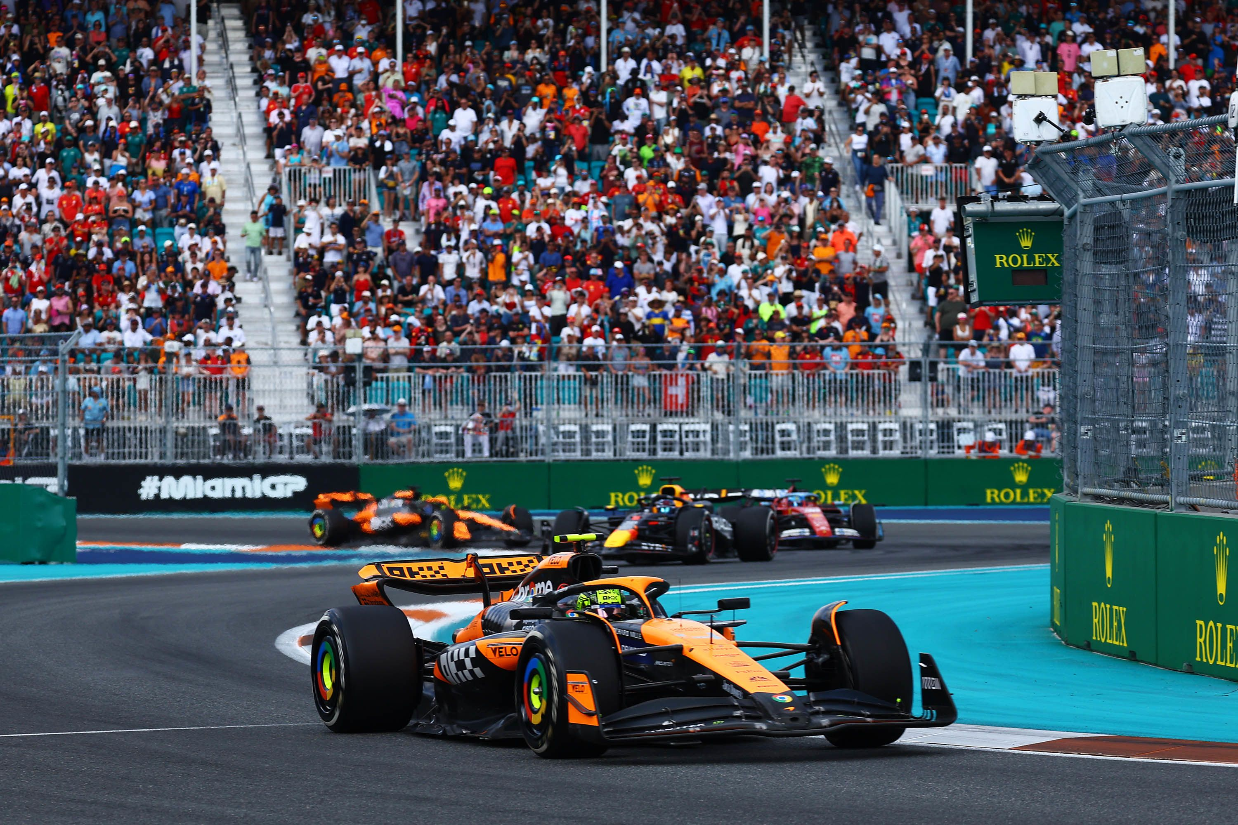
Models
Advanced models (neural networks or deep learning architectures)
Sequential and time-series information from lap-by-lap data (Jia et al., 2025)
Difficult to interpret and require preprocessing
Notes:
Advanced models (neural networks or deep learning architectures)
Incorporate sequential and time-series information from telemetry or lap-by-lap data (Jia et al., 2025)
Often difficult to interpret and require extensive preprocessing and computational resources

Slide 12
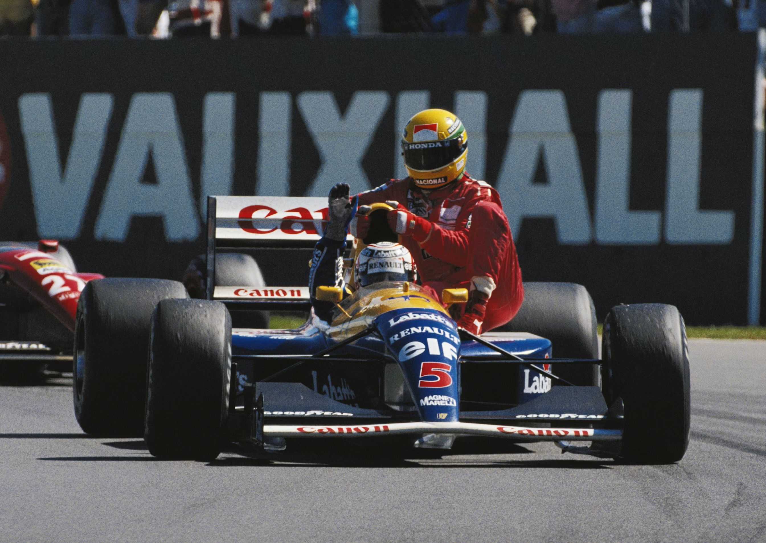
Models
Hierarchical and k-Means clustering
Suited for exploring driver performance and circuit characteristics
Hierarchical clustering is useful for visualizing nested relationships between drivers or circuits
k-Means provides a straightforward approach to partitioning data into distinct clusters of similar traits
Notes:
Hierarchical and k-Means clustering
Well suited for exploring driver performance and circuit characteristics
Allows drivers to be grouped based on shared performance traits and circuits to be categorized according to characteristics (overtaking difficulty, pit stop patterns, and tire degradation)
Hierarchical clustering is useful for visualizing nested relationships between drivers or circuits
While k-Means provides a straightforward approach to partitioning data into distinct clusters of similar traits

Slide 13
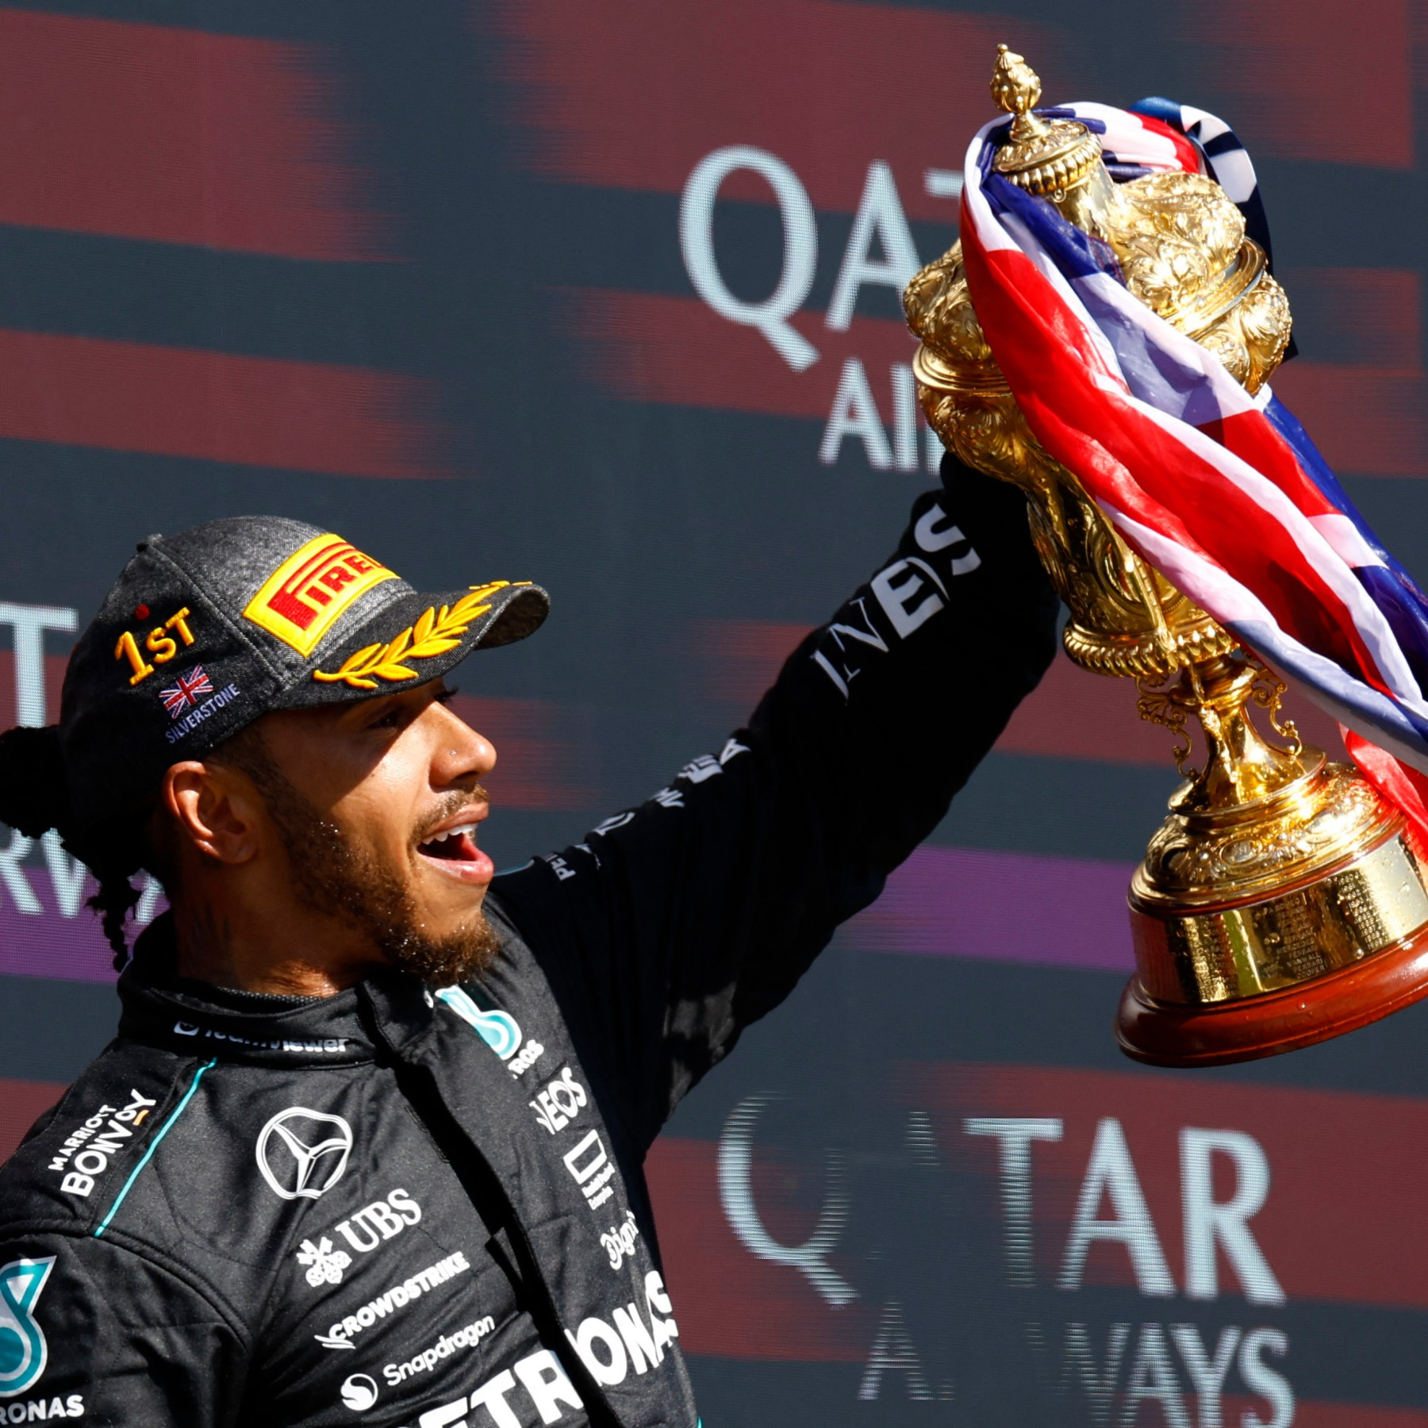
Best Model
Given complexity of predicting F1 race outcomes and limitations of available data, hierarchical and k-Means clustering were selected as the primary analytical methods for this project
Enables classification of drivers and circuits, and identification of drivers who perform consistently well under different track conditions

Slide 14
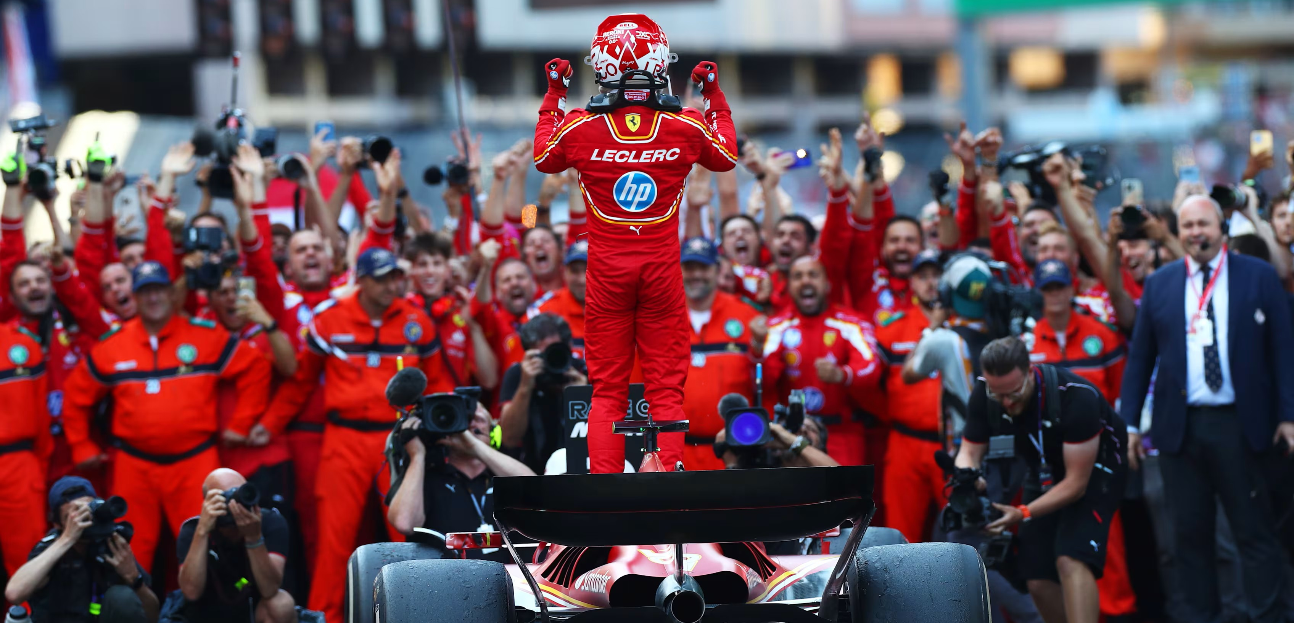
Final Product
Who really is the “goat” of Formula 1?
Notes:
My final product will “hopefully” be a computer-generated diagram relating the tracks and drivers and correlating each driver to a track they are consistently good at, and what the characteristics of that track it. This means that, using this information, I can figure out what type of driver each driver on the grid is, and see what anomalies there are, (i.e. drivers who are good at all the tracks, who overcome conditions that they are not supposedly good at, who really is the “goat” of F1?)

Slide 15

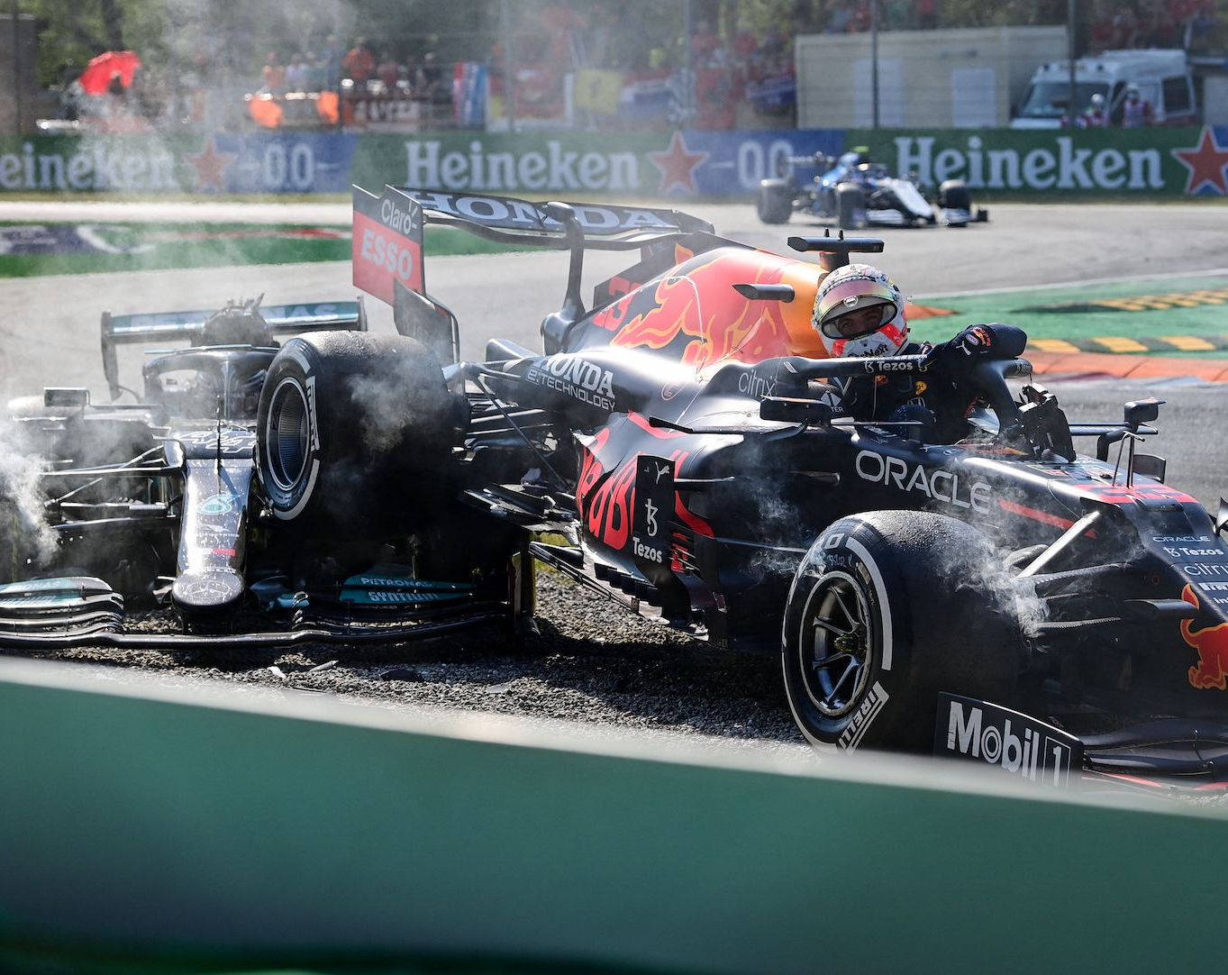
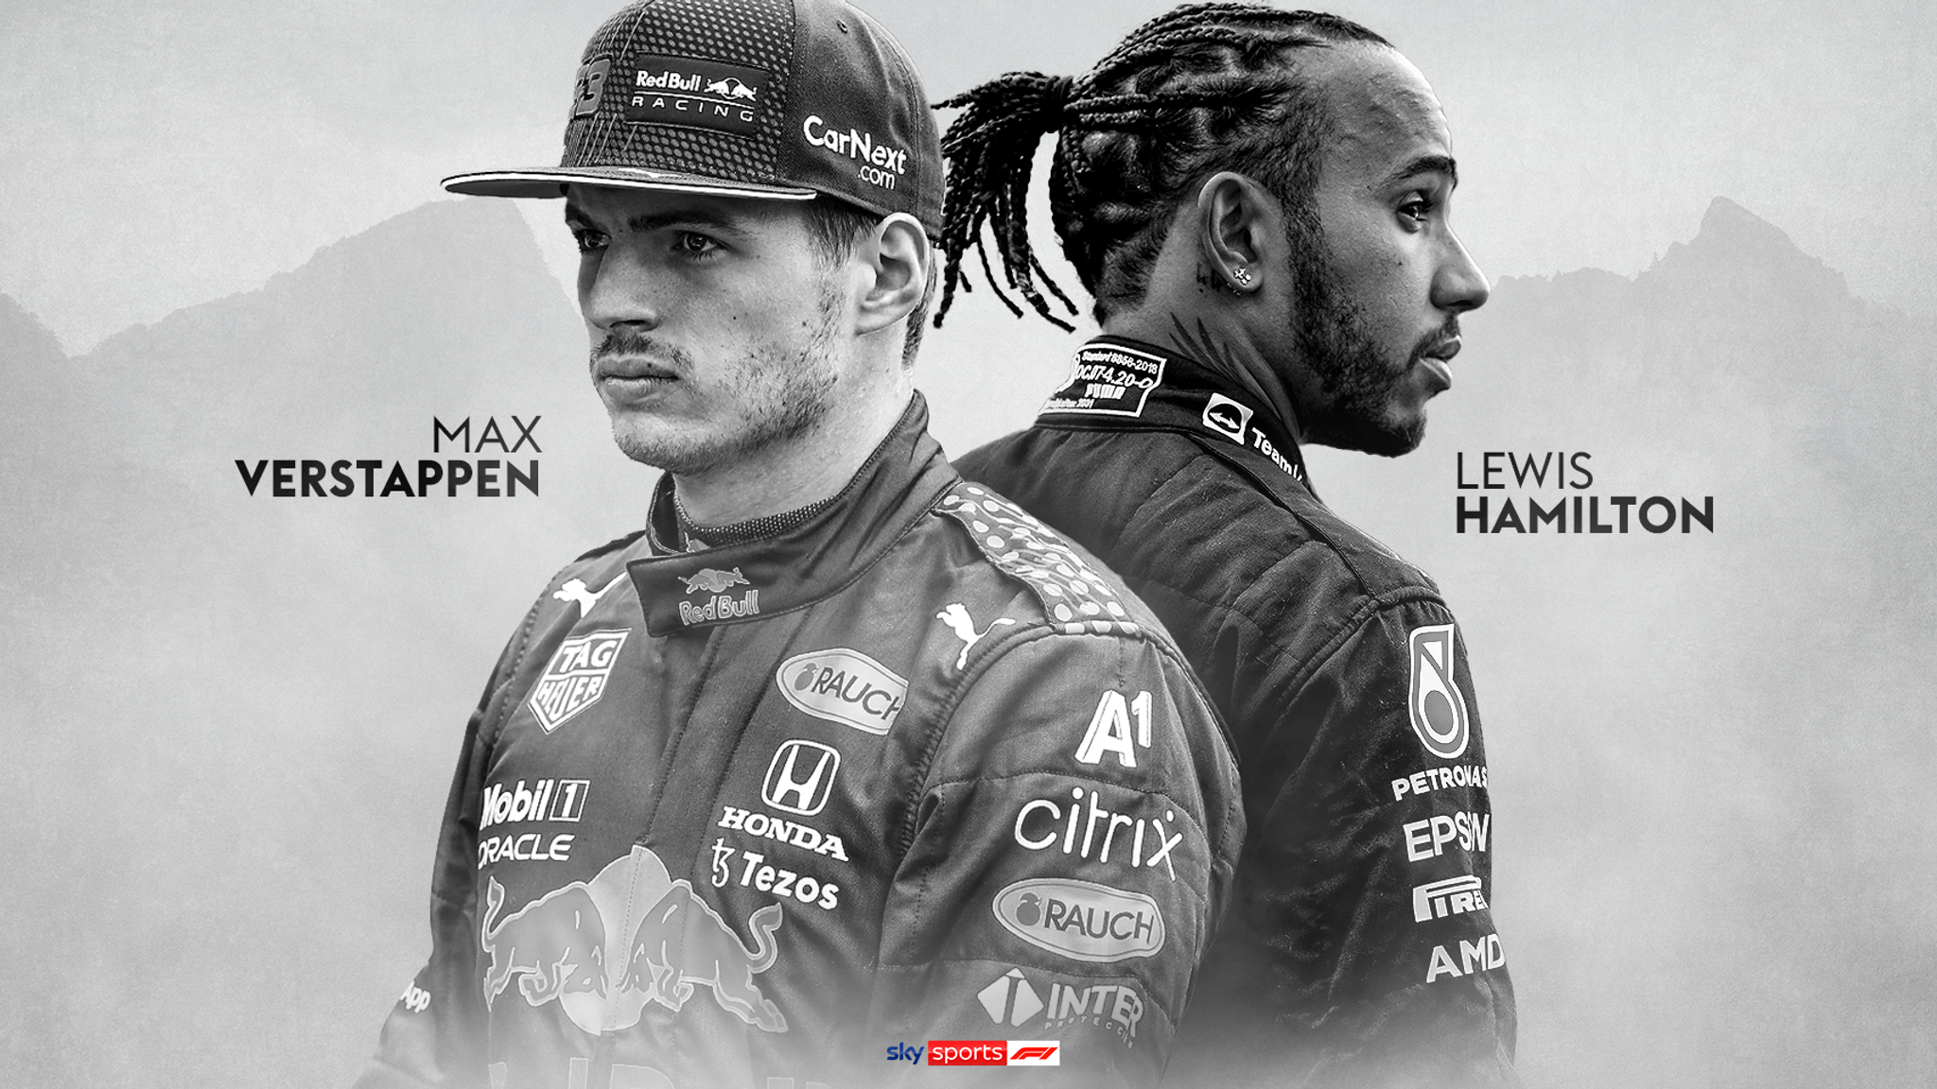

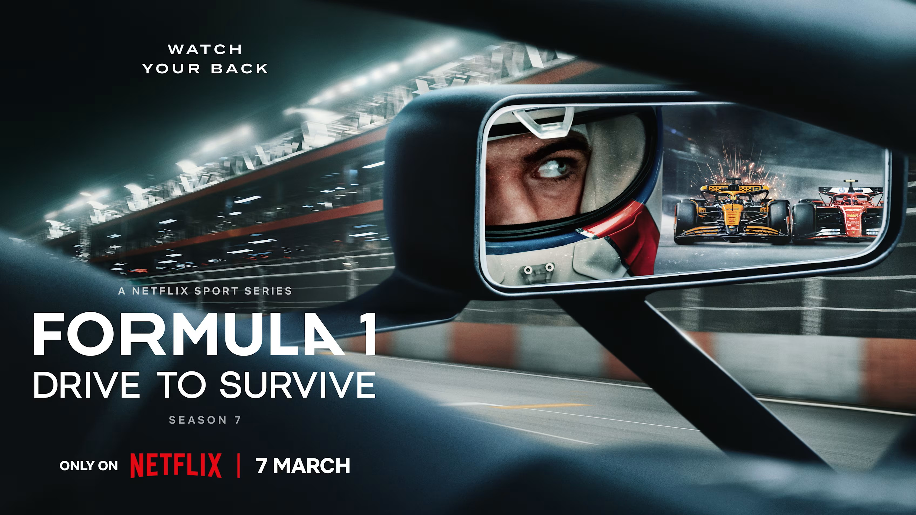
Relevance
Rise in popularity
F1: The Movie
2021 season
Drive to Survive
Notes:
Formula 1 is only becoming more popular, with the release of the f1 movie and shows like drive to survive making it more accessible to understand the sport. The hallmark 2021 season was a big factor in popularity, as it brought in many fans with the tense storyline of Max Verstappen versus Lewis Hamilton, and they were going into the final race tied in points, the script essentially wrote itself. Formula 1 is only growing, and with it its influence.

